Slide 1
”DIKSHA” Sundaram Fin.Tech 2025
Anil Rasa
Date : 19-Apr-2025

Slide 2
About Me
"Learn today, lead tomorrow."

Slide 3
Covered Topics
→Etiquettes
→Dialects
→Diction

Slide 4

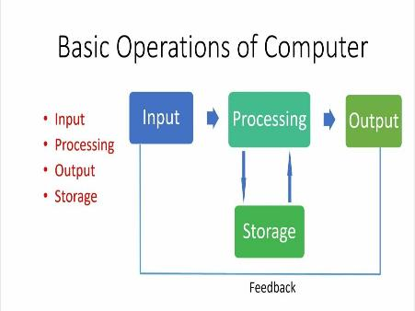
Day1| Fundamentals of Computer
Computer Operations:
→Input -Processor - Output -Storage
Monitor Resolution:
Monitor resolution describes the visual dimensions of any given display.
Printers:
A printer is a device that prints text and images onto paper or other materials.
→1.Laser 2.Intjet 3.Dot Matrix
Networks:
A network consists of two or more computers that are linked in order to share resources (such as printers and CDs), exchange files, or allow electronic communications.
→LAN (Local Area Network), WAN (Wide Area Network), and MAN (Metropolitan Area Network)
Software Development Life Cycle:
SDLC stands for Software Development Life Cycle. It's a structured process that helps development teams design, build, and maintain software.
→phases are 1.Plannig 2.Designing 3.Development 4.Testing 5.Maintanance or Support.
Environment:
An environment can refer to the hardware and software used to develop software, or the set of resources used to run a program.
Q

Slide 5
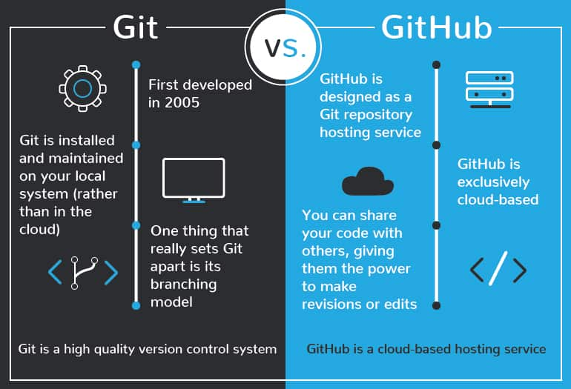
Day2| Fundamentals of Computer
Agile:
Agile is a project management approach that emphasizes quick delivery, collaboration, and adaptability.
Agile principles:
Agile principles are the core guidelines that help teams deliver value to customers more effectively.
→Simplicity, Customer satisfaction, Self-organizing teams, Effective communication.
Git and Github:
1)Git is a software where as git hub is a service.
2)Git is a command line tool, Git is installed in our local system.
3)Git provides the graphical user interface.
4) A repository is the most basic element of GitHub. It's a place where you can store your code, your files.
Commnads in git → 1.git init 2.git add 3.git reset 4.git status 5.git log 6.git push 7.git pull 8.git clone
version control systems:
A version control system (VCS) tracks every alteration to a file or set of files, enabling developers to journey back to earlier versions and collaborate seamlessly, Types(centralized and distributed).
Azure :
Azure is a cloud computing platform that offers services for storage, networking, analytics, and more.

Slide 6
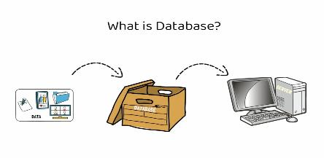
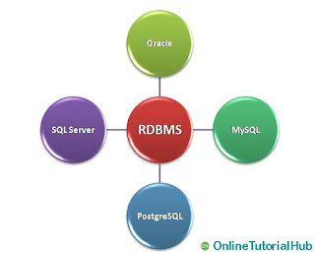
Day 3 | RDBMS
Data: Data is a collection of images,audio,videos,pdf,etc.
Database: Database A database is an organized collection of structured information, or data, typically stored electronically in a computer system
Queries in Database:
Data query language (DQL)→select 2)Data definition language (DDL)→create,alter,rename,drop,truncate
3)Data Manipulations language(DML)→ insert,update,delete,merge. 4)Transaction control language (TCL)
→commit,rollback,savepoint 5)Data control language(DTL)→grant,revoke
Structured query language (SQL) :
Structured query language (SQL) is a programming language for storing and processing information in a relational database.
→Initially SQL was named as SEQUEL (Structured Engilsh Query Language) invented by IBM in 1970 developers are ”Donald Chamberlin and Raymond Boyce”
DBMS: Database Management System (DBMS) is a software system that allows users to create, define, manipulate and manage databases.
types of DBMS are Relational DBMS (RDBMS), Hierarchical DBMS,and Object-Oriented DBMS (OODBMS).
RDBMS: Relational database is organize the data in a table format which means rows and columns.
Ex:-MySQL,PostgreSQL,Oracle,Microsoft-access
No-SQL: In this Database the data is not organized in a particular structure.
Ex:-Mango-DB, Apache Cassandra.
Oracle: Oracle Database is a relational database management system (RDBMS) that stores and organizes data in tables and columns.
Larry Ellison, Bob Miner, and Ed Oates developed Oracle.

Slide 7

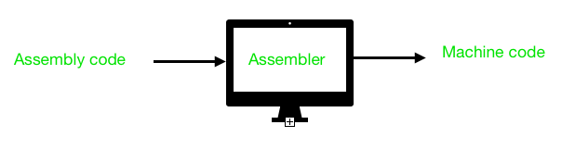
Day 4 |
Algorithm:An algorithm is a set of instructions that can be followed to complete a task or solve a problem
Assembly Language: It is a low-level programming language that allows programmers to write instructions that directly control a computer's hardwares
Assembler: an assembler is a piece of software that converts instructions written in assembly language to
computer-readable machine code
→Types of algorithms:There are many types of algorithms, including dynamic programming, greedy algorithms,
backtracking, binary search, brute force, divide and conquer, linear regression, and machine learning.
Flowchart: Graphical representation of the steps to be covered for solving problems.
→It is consist of set of symbols and steps.Each symbol represent a specific action.
It is very easy to understand to identify better than algorithm.but symbols can’t be typed.
Pseudocode: is a detailed yet readable description of what a computer program or algorithm should do.
Variable:It is a name to store the different data
Types are:-1)Numeric→numeric variable can contain only numbers 2)character→ it is combination of letters,number,special characters.
Operators:Operator is a symbol used to perform some operations between variables or operands
Types of operators:1) Arthematic operators(+,-,*,/,%,) 2)Relational Operators(<,>,<=,>=,==,!=) 3) logical operators(AND ,OR,NOT)
Decision-making statements : execute a block of code based on a condition.
Types are: 1)if
2)if-else
3)if-else-if

Slide 8

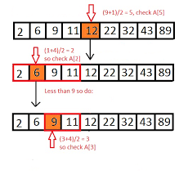
Day 4 | Continuation
4) Switch Statement :Instead of writing if else if we can use switch statement.
→Switch statement is always associated with Break statement.
Syntax: Switch(condition):
begin
case1:
execute the statements
break;
case2:
execute the statements
break;
end
Iterative Statements: Iterative statements are used to execute the number of statements number of times as per the application requirements
1)for loop
2)while loop
3)do while loop
Time Complexity :
Time complexity is a type of computational complexity that describes the time required to execute an algorithm.
Search:
Searching is the process of finding a particular piece of information or data from a larger set of data or information.
1) Linear search:
Linear search or sequential search is a method for finding an element within a list. It sequentially checks
each element of the list until a match is found or the whole list has been searched.
→2)Binary Search:
→Binary Search is a searching algorithm for finding an element's position in a sorted array.

Slide 9
Thank You

